Slide 1
Module Goals
Introduce structural VHDL constructs
  Use of components
  Component binding indications
  Use of configuration declarations
  GENERATE statements
Notes:
The goals of this module are to introduce the concepts and constructs supporting structural modeling using VHDL. These include the mechanisms for incorporating other VHDL design objects into an architecture description. In addition, some powerful VHDL utilities that facilitate the design of systems with regular structures and constructs to support configuration control will be presented. The goal of this module is to bring the student to the point where she/he will be able to write code using the concepts of structural design in VHDL.

Slide 2
Module Outline
Generate Statement
Examples
Summary

Slide 3
Generate Statement
VHDL provides the GENERATE statement to create well-patterned structures easily
  Some structures in digital hardware are repetitive in nature (e.g. RAMs, adders)
Any VHDL concurrent statement may be included in a GENERATE statement, including another GENERATE statement
  Specifically, component instantiations may be made within GENERATE bodies
Notes:
Structural descriptions of large, but highly regular, structures can be tedious. A VHDL GENERATE statement can be used to include as many concurrent VHDL statements (e.g. component instantiation statements) as needed to describe a regular structure easily. In fact, a GENERATE statement may even include other GENERATE statements for more complex devices.. Some common examples include the instantiation and connection of multiple identical components such as half adders to make up a full adder, or exclusive or gates to create a parity tree.

Slide 4
Generate Statement
FOR-Scheme
All objects created are similar
The GENERATE parameter must be discrete and is undefined outside the GENERATE statement
Loop cannot be terminated early
name : FOR N IN 1 TO 8 GENERATE
concurrent-statements
END GENERATE name;
Notes:
VHDL provides two different schemes of the GENERATE statement, the FOR-scheme and the IF-scheme. This slide shows the syntax for the FOR-scheme.
The FOR-scheme is reminiscent of a FOR loop used for sequence control in many programming languages. The FOR-scheme generates the included concurrent statements the assigned number of times. In the FOR-scheme, all of generated concurrent statements must be the same. The loop variable is created in the GENERATE statement and is undefined outside that statement (i.e. it is not a variable or signal visible elsewhere in the architecture).
The syntax for the FOR-scheme GENERATE statement is shown in the slide. The loop variable in this case is N. The range can be any valid discrete range. After the GENERATE keyword, the concurrent statements to be generated are stated, and the GENERATE statement is closed with END GENERATE.

Slide 5
FOR-Scheme Example
-- this uses the and_gate component from before
ARCHITECTURE test_generate OF test_entity IS
SIGNAL S1, S2, S3: BIT_VECTOR(7 DOWNTO 0);
BEGIN
G1 : FOR N IN 7 DOWNTO 0 GENERATE
and_array : and_gate
GENERIC MAP (2 ns, 3 ns)
PORT MAP (S1(N), S2(N), S3(N));
END GENERATE G1;
END test_generate;
S2(7:0)
S1(7:0)
S3(7:0)
Notes:
This slide shows an example of the FOR-scheme. The code generates an array of AND gates. In this case, the GENERATE statement has been named G1 and instantiates an array of 8 and_gate components. The PORT MAP statement maps the interfaces of each of the 8 gates to specific elements of the S1, S2, and S3 vectors by using the FOR loop variable as an index.

Slide 6
Generate Statement
IF-Scheme
Allows for conditional creation of components
Cannot use ELSE or ELSIF clauses with the
IF-scheme
name : IF (boolean expression) GENERATE
concurrent-statements
END GENERATE name;
Notes:
The second form of the GENERATE statement is the IF-scheme. This scheme allows for conditional generation of concurrent statements. One obvious difference between this scheme and the FOR-scheme is that all the concurrent statements generated do not have to be the same. While this IF statement may seem reminiscent to the IF-THEN-ELSE constructs in programming languages, note that the GENERATE IF-scheme does not provide ELSE or ELSIF clauses.
The syntax of the IF-scheme GENERATE statement is shown in this slide. The boolean expression of the IF statement can be any valid boolean expression.

Slide 7
IF-Scheme Example
ARCHITECTURE test_generate OF test_entity
SIGNAL S1, S2, S3: BIT_VECTOR(7 DOWNTO 0);
BEGIN
G1 : FOR N IN 7 DOWNTO 0 GENERATE
G2 : IF (N = 7) GENERATE
or1 : or_gate
GENERIC MAP (3 ns, 3 ns)
PORT MAP (S1(N), S2(N), S3(N));
END GENERATE G2;
G3 : IF (N < 7) GENERATE
and_array : and_gate
GENERIC MAP (2 ns, 3 ns)
PORT MAP (S1(N), S2(N), S3(N));
END GENERATE G3;
END GENERATE G1;
END test_generate;
Notes:
The example here uses the IF-scheme GENERATE statement to make a modification to the and_gate array such that the seventh gate of the array will be an or_gate.
Another example use of the IF-scheme GENERATE is in the conditional execution of timing checks. Timing checks can be incorporated inside a GENERATE IF-scheme. For example, the following statement can be used:
Check_time : IF TimingChecksOn GENERATE
This allows the boolean variable TimingChecksOn to enable timing checks by generating the appropriate concurrent VHDL statements in the description. This parameter can be set in a package or passed as a generic and can improve simulation speed by shutting off this computational section.

Slide 8
Module Outline
Introduction
Component Instantiation
Generate Statement
Examples
Summary

Slide 9
Examples
Build higher level modules from the library of basic gates
  8 Bit Register using DFFs
  8 Bit Shift Register using Multiplexors and DFFs

Slide 10
Structural 8 Bit Register Example
Simple Generate Statement
LIBRARY gate_lib;
USE gate_lib.resources.all;
ENTITY reg8_str IS
GENERIC(tprop : delay := 8 ns;
tsu : delay := 2 ns);
PORT(d : IN level_vector(7 DOWNTO 0);
clk : IN level;
enable : IN level;
q : OUT level_vector(7 DOWNTO 0);
qn : OUT level_vector(7 DOWNTO 0));
END reg8_str;
ARCHITECTURE structural OF reg8_str IS
-- COMPONENT DECLARATION
COMPONENT dff
GENERIC(tprop : delay;
tsu : delay);
PORT(d : IN level;
clk : IN level;
enable : IN level;
q : OUT level;
qn : OUT level);
END COMPONENT;
-- BINDING INDICATIONS
FOR ALL : dff USE ENTITY gate_lib.dff(behav);
BEGIN
-- COMPONENT INSTANTIATION (GENERATE)
R1:FOR i IN 1 TO 8 GENERATE
I1:dff GENERIC MAP(tprop => tprop,
tsu => tsu)
PORT MAP(d => d(i-1), clk => clk,
enable => enable,
q => q(i-1), qn => qn(i-1));
END GENERATE R1;
END structural;
D(0)
D(1)
D(2)
D(7)
CLK
ENABLE
D
D
D
D
CLK
CLK
CLK
CLK
E
Q
Qn
E
Q
Qn
E
Q
Qn
E
Q
Qn
Q(0)
Q(1)
Q(2)
Q(7)
Qn(0)
Qn(1)
Qn(2)
Qn(7)
Notes:
This is a structural description of an 8 bit register using DFFs from the library. A simple generate statement is used to instantiate the DFFs and connect them to the individual “bits” at the register’s input and output. The colors highlight the same parts of the structural description as before.

Slide 11
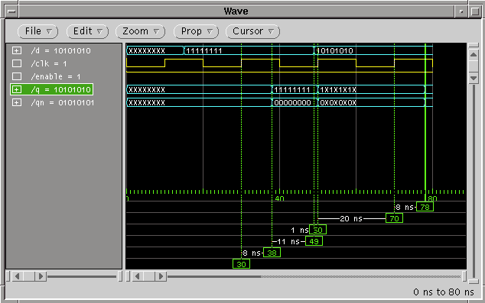
Structural 8 Bit Register Simulation Results
Notes:
Simulation results showing correct function.

Slide 12
Structural 8 Bit Shift Register Example
(Entity)
LIBRARY gate_lib;
USE gate_lib.resources.all;
ENTITY shift_reg8_str IS
GENERIC(tprop : delay := 15 ns;
tsu : delay := 2 ns);
PORT(d : IN level_vector(7 DOWNTO 0);
clk : IN level;
enable : IN level;
scan_in : IN level;
shift : IN level;
scan_out : OUT level;
q : OUT level_vector(7 DOWNTO 0));
END shift_reg8_str;
D(0)
D(1)
D(2)
D(7)
SHIFT
SCAN_IN
CLK
ENABLE
D
D
D
D
CLK
CLK
CLK
CLK
E
Q
E
Q
E
Q
E
Q
SCAN_OUT
Q(0)
Q(1)
Q(2)
Q(7)
Notes:
This is the schematic and entity description for and 8 bit shift register.
Note that in the schematic, signals will be needed between the multiplexor output and the dff’s input and the dff output and the shift register output (Q). The signal on the DFF outputs is needed because it feeds back to the input of the muxes, and that can’t be done by connecting both directly to an output port (until VHDL-93 in which OUT ports are readable inside the architecture). Thus, some concurrent signal assignment statements will be necessary to connect the signal at the dff outputs to the Q outputs.

Slide 13
Structural 8 Bit Shift Register Example
(Architecture - Generate with If Scheme)
ARCHITECTURE structural OF shift_reg8_str IS
-- COMPONENT DECLARATION
COMPONENT mux2
GENERIC(tprop : delay);
PORT(a : IN level;
b : IN level;
sel : IN level;
c : OUT level);
END COMPONENT;
COMPONENT dff
GENERIC(tprop : delay;
tsu : delay);
PORT(d : IN level;
clk : IN level;
enable : IN level;
q : OUT level;
qn : OUT level);
END COMPONENT;
-- BINDING INDICATIONS
FOR ALL : mux2 USE ENTITY
gate_lib.mux2(behav);
FOR ALL : dff USE ENTITY
gate_lib.dff(behav);
SIGNAL mux_out : level_vector(7 DOWNTO 0);
SIGNAL dff_out : level_vector(7 DOWNTO 0);
BEGIN
-- COMPONENT INSTANTIATION (GENERATE W/ IF)
G1:FOR i IN 0 TO 7 GENERATE
G2 : IF (i = 0) GENERATE
MUX1 : mux2 GENERIC MAP(tprop => tprop/2)
PORT MAP(a => scan_in,
b => d(i),
sel => shift,
c => mux_out(i));
DFF1 : dff GENERIC MAP(tprop => tprop/2,
tsu => tsu)
PORT MAP(d => mux_out(i),
clk => clk,
enable => enable,
q => dff_out(i));
q(i) <= dff_out(i);
END GENERATE G2;
G3 : IF (i > 0) GENERATE
MUX1 : mux2 GENERIC MAP(tprop => tprop/2)
PORT MAP(a => dff_out(i-1),
b => d(i),
sel => shift,
c => mux_out(i));
DFF1 : dff GENERIC MAP(tprop => tprop/2,
tsu => tsu)
PORT MAP(d => mux_out(i),
clk => clk,
enable => enable,
q => dff_out(i));
q(i) <= dff_out(i);
END GENERATE G3;
END GENERATE G1;
scan_out <= dff_out(7);
END structural;
Notes:
This is the architecture which uses a complex generate statement. There is an IF statement within the generate statement to handle the fact that the mux that is connected to the 0th bit is connected to scan_in instead of the output of the DFF in the previous bit position. Here again, the colors highlight the three parts of the structural description.
Note that the concurrent signal assignment statements to connect the dff_out signal to the Q outputs are inside the generate statements.

Slide 14
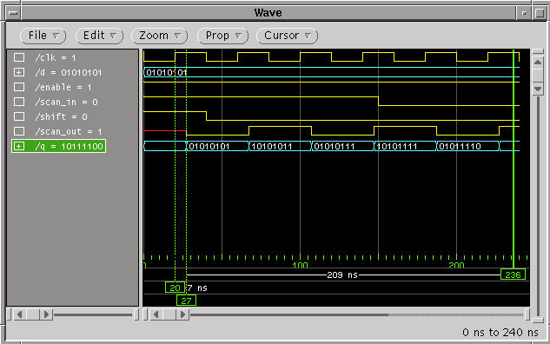
Structural 8 Bit Shift Register Simulation Results
Notes:
Here is the simulation results showing a parallel load followed by scanning the loaded data.

